Slide 1
Python and DateTime
# There is no date data type in python
# To deal with date and time you need to use DateTime built in module of python
# For Ex - Current date can be displayed as follow
import datetime as dt # importing the module x = dt.datetime.now() # Note : datetime represent constructor of datetime class print(x)
Output will be in following format :
2023-05-25 16:02:23.115559
Note * : It contains year, month, day, hour, minute, second, and microsecond

Slide 2
DateTime module methods
# There are many methods to give information about date object
# For Ex – Getting the year and name of weekday using current date object
import datetime as dt x = dt.datetime.now() # To get current date object print(x.year) # To display year
print(x.strftime("%A")) # To display day name
Output will be like :
2023 Thursday

Slide 3
Creating Date Objects
# you can create a date object using datetime class constructor of the datetime module
# And you have to pass three parameters values : year , month and day in constructor
# The datetime() class also takes parameters for time and timezone
(i.e : hour, minute, second, microsecond, tzone), but they are optional, and has a
default value of 0, (None for timezone)
# For Ex – Creating a date object
import datetime x = datetime.datetime(2020, 5, 17) print(x)
Output will be : 2020-05-17 00:00:00

Slide 4
The strftime() Method
# This method is used for formatting date objects into readable strings.
# It takes one parameter, format, to specify the format of the returned string
# For Ex – Displaying the name of the month
import datetime x = datetime.datetime(2018, 6, 1) # Creating a specific date object print(x.strftime("%B")) # Getting month information from date object
Output will be : June

Slide 5
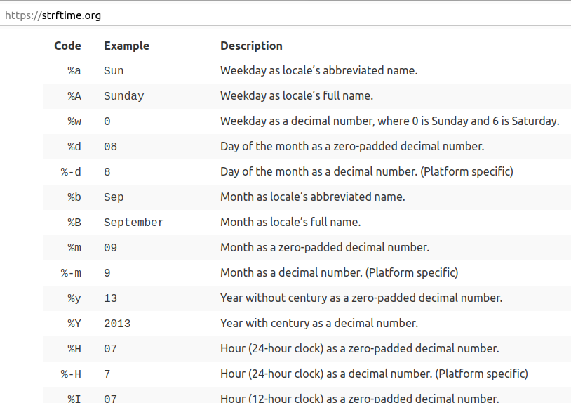
# Few Examples of format code to be pass in strftime() method :

